Slide 1
Big Data
HBase Basics
LEVEL – PRACTITIONER

Slide 2
Madhura Verma
PA-Big Data
1.0

Slide 3









Icons Used
Hands on Exercise
Questions
Tools
Coding Standards
Test Your Understanding
Case Study
Best Practices & Industry Standards
Demonstration
Workshop

Slide 4
Overview
This chapter will cover the concepts of HBase and HBase Java Client API in detail.

Slide 5
Objectives
After completing this chapter you will be able to:
Describe what is HBase
Understand Difference between RDBMS and HBase
Describe HBase Data Model
Describe High Level Architecture of HBase
Understand Basic HBase Terminology
Explain Write Path and Read Path
Describe HBase Installation
Explain Shell Commands for HBase
Understand Java Client API for HBase
Describe Types of Access

Slide 6
HBASE INTRODUCTION

Slide 7

What is HBase?
HBase is an open source, non-relational, distributed database modeled after Google's BigTable and written in Java.
Think of it as a sparse, consistent, distributed, multidimensional, sorted map:
labeled tables of rows
row consist of key-value cells:
(row key, column family, column, timestamp) -> value

Slide 8
What is HBase?
HBase is a type of "NoSQL" database.
"NoSQL" is a general term meaning that the database isn't an RDBMS which supports
SQL as its primary access language, but there are many types of NoSQL databases:
Key-Value Store – It has a Big Hash Table of keys & values {Example- Riak, Amazon S3 (Dynamo)}
Document-based Store - It stores documents made up of tagged elements. {Example- CouchDB}
Column-based Store - Each storage block contains data from only one column, {Example- HBase, Cassandra}
Graph-based-A network database that uses edges and nodes to represent and store data. {Example- Neo4J}

Slide 9
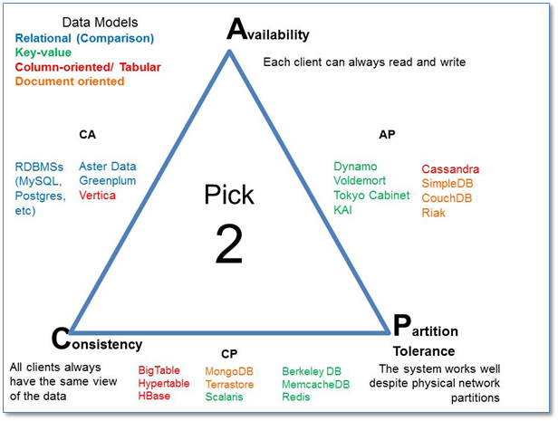
What is CAP Theorem

Slide 10
Why use HBase?
Storing large amounts of data(TB/PB)
Storing unstructured or variable column data
Big Data with random read and writes
Horizontally scalable
Automatic sharding
Strongly consistent reads and writes
Simple Java API
Integration with Map/Reduce framework

Slide 11
What HBase is not?
Not an SQL database
Not relational
No joins
No fancy query language and no sophisticated query engine
No transactions out-of-the box
No secondary indices out-of-the box
Not a drop-in replacement for your RDBMS

Slide 12
RDBMS vs HBase
HBase | RDBMS
Column-oriented | Row oriented (mostly)
Flexible schema, add columns on the fly | Fixed schema
Good with sparse tables | Not optimized for sparse tables
No query language | SQL
Wide tables | Narrow tables
Joins using MR –not optimized | Optimized for joins (small, fast ones too!)
Tight integration with MR | Not really...
De-normalize your data | Normalize as you can
Horizontal scalability –just add hardware | Hard to shard and scale
Consistent | Consistent
No transactions | Transactional
Good for semi-structured data as well as structured data | Good for structured data

Slide 13
HBase Data Model
Every row has a row key (analogous to a primary key)
Rows are stored by row key for fast lookups
A table may have 1 or more column families
Common to have a small number of column families
A column family can have number of columns
Each row has a timestamp
Multiple versions of a row can exist

Slide 14
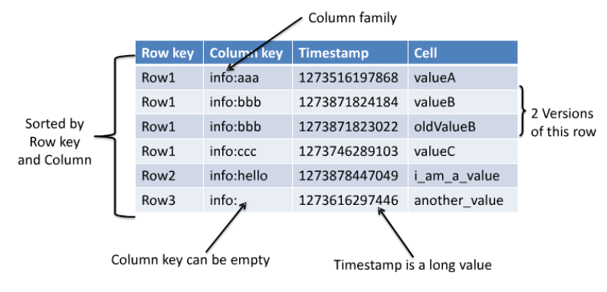
HBase Data Model
Table is a distributed sorted map
row key + column family + column + timestamp -> value

Slide 15
Column Family Attributes
BLOCKSIZE
1byte – 2GB
By Default: 64k
IN_MEMORY
True, False
By Default: False
BLOCKCACHE
True, False
By Default: True
COMPRESSION
NONE, GZ, LZO
By Default: NONE
VERSIONS
1+
By Default: 3
TTL
1-2147483647
By Default: 2147483647

Slide 16
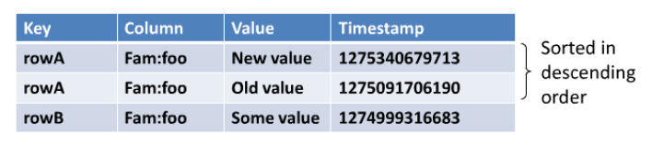
Versions of Data
Keeps 3 versions of a row
Sorted by their timestamp (descending order)

Slide 17
HBase Daemons
HMaster
-Responsible for coordinating the slaves (HRegionServer)
-Assigns regions, detects failures of HRegionServers and controls some admin
functions
HRegionServer
-Serves data for reads and writes
HQuorumPeer
-It is known as ZooKeeper.
-In HBase, ZooKeeper coordinates, communicates, and shares state between the
Masters and RegionServers.

Slide 18
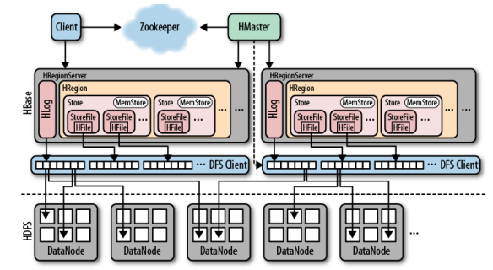
HBase High Level Architecture

Slide 19
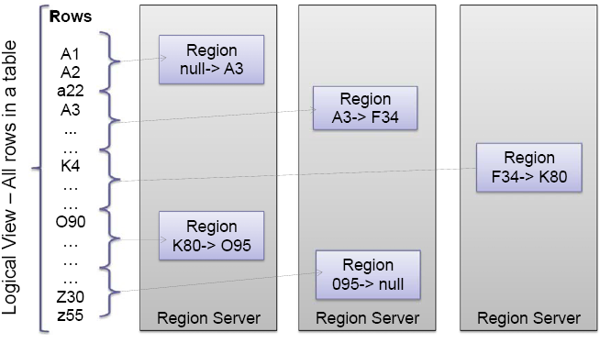
Rows Distribution Between Region Servers

Slide 20
Few HBase Terminology
Table -HBase table
Region -Regions for the table
Store -Store per ColumnFamily for each Region for the table
MemStore -MemStore for each Store for each Region for the table
StoreFile -StoreFiles for each Store for each Region for the table
Block -Blocks within a StoreFile within a Store for each Region for the table

Slide 21
HBase Internals
Zookeeper
Stores global information about the cluster
-ROOT-
A table that lists the .META. Tables
.META.
A table that lists all the regions and their locations

Slide 22
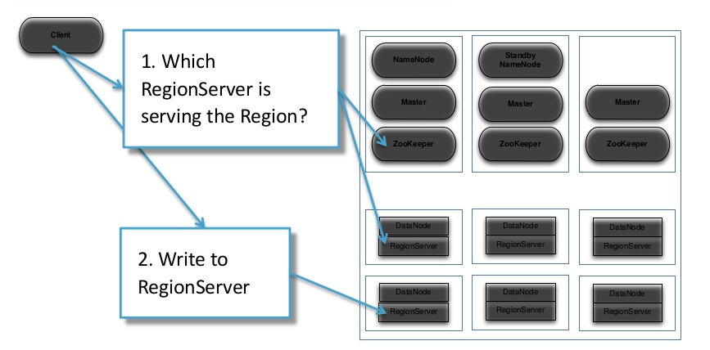
Write Path

Slide 23
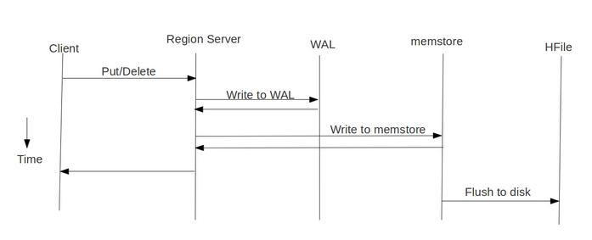
Write Path

Slide 24
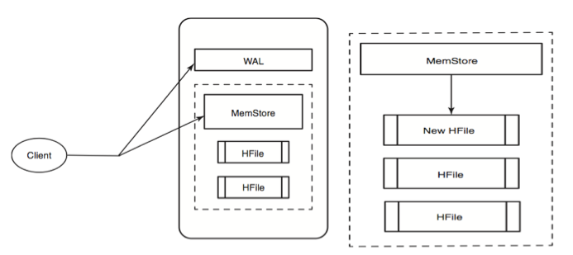
Write Path

Slide 25
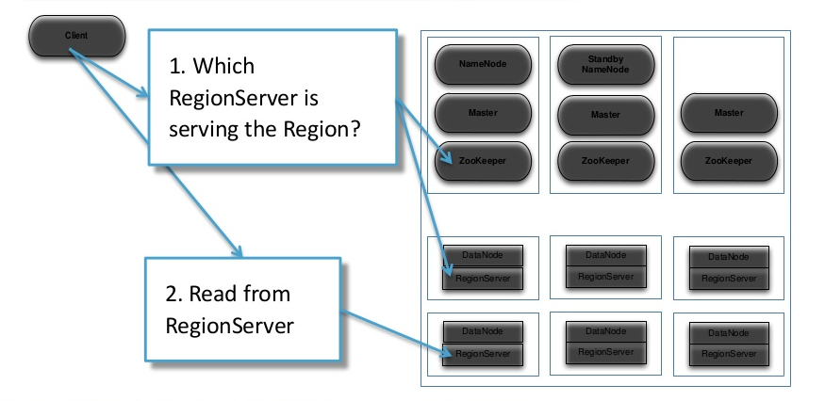
Read Path

Slide 26
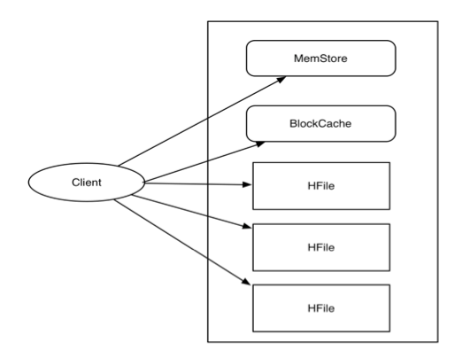
Read Path

Slide 27
HBase Installation
Download recent version of hbase-X.XX.X.tar.gz from hbase.apche.org
hbase-env.sh
export JAVA_HOME=/usr/jdk1.6.0_32/
export HBASE_HEAPSIZE=1000
export HBASE_MANAGES_ZK=true
hbase-site.xml
hbase.rootdir
hbase.zookeeper.property.datadir
fs.default.name
hbase.zookeeper.quorum
regionservers
bin/start-hbase.sh

Slide 28
HBase Default Ports
master
RPC - 60000
UI – 60010
regionservers
RPC - 60020
UI - 60030

Slide 29
Hbase Shell Commands
help
Lists all the shell commands
status
Shows basic status about the cluster
list
Lists all user tables in HBase
describe <table name>
Returns the structure of the table

Slide 30
Create Command
create 't1', {NAME => 'cf1', VERSIONS => 5}
create 't1', {NAME => 'cf1'}, {NAME => 'cf2'}, {NAME => 'cf3'}
create 't1', 'cf1', 'cf2', 'cf3'
create 't1', {NAME => 'cf1', VERSIONS => 1, TTL => 2592000, BLOCKCACHE => true}

Slide 31
Get & Put Command
get 't1', 'r1'
get 't1', 'r1', {TIMERANGE => [ts1, ts2]}
get 't1', 'r1', {COLUMN => 'c1'}
get 't1', 'r1', {COLUMN => ['c1', 'c2', 'c3']}
put 't1', 'r1', 'c1', 'value', ts1

Slide 32
Scan Command
scan 't1'
scan 't1', {COLUMNS => ''}
scan 't1', {COLUMNS => ['c1', 'c2'], LIMIT => 10, STARTROW => 'xyz'}
scan 't1', {COLUMNS => 'c1', TIMERANGE => [1303668804, 1303668904]}
scan 't1', {COLUMNS => ['c1', 'c2'], CACHE_BLOCKS => false}

Slide 33
Count Command
count 't1'
count 't1', INTERVAL => 100000
count 't1', CACHE => 1000
count 't1', INTERVAL => 10, CACHE => 1000

Slide 34
For More Shell Commands
Refer in the following links:
http://learnhbase.wordpress.com/2013/03/02/hbase-shell-commands/
http://bigdatariding.blogspot.in/2013/12/hbase-shell-commands.html

Slide 35
Test Your Understanding
What is CAP theorem?
What are the differences between RDBMS and HBase?
What are column family attributes?
What are MemStore and StoreFile?
What are Default Ports for HBase?

Slide 36
HBase Java Client API
Basic CRUD operations

Slide 37
HBase Java Client API
You must:
Create your own connections
Keep track of the type of data in a column
Give each row a key
Access a row by its key

Slide 38
Types of Access
Gets
Gets a row’s data based on the row key
Puts
Insert & Update a row with data based on the row key
Scans
Finds all matching rows based on the row key
Scan logic can be increased by using filters

Slide 39
Create HBase Table
Configuration conf = HBaseConfiguration.create();
conf.set("hbase.zookeeper.quorum", "127.0.0.1");
conf.set("hbase.zookeeper.property.clientPort", "2181");
HBaseAdmin admin = new HBaseAdmin(conf);
String name = "NewTable";
byte [] tableName = Bytes.toBytes(name);
HTableDescriptor table = new HTableDescriptor(tableName);
HColumnDescriptor family =
new HColumnDescriptor(Bytes.toBytes("new_family"));
table.addFamily(family);
System.out.println("Table "+name+" exist: " +
admin.tableExists(tableName)) ;
System.out.println("Creating "+name+" table...");
admin.createTable(table);
System.out.println("Table "+name+" exist: " +
admin.tableExists(tableName)) ;

Slide 40
Gets
Get g = new Get(ROW_KEY_BYTES);
Result r= table.get(g);
byte[] byteArray =
r.getValue(COLFAM_BYTS,COLDESC_BYTS);
String columnValue = Bytes.toString(byteArray);

Slide 41
Puts
Put p = new Put(Bytes.toBytes(ROW_KEY_BYTES);
p.add(COLFAM_BYTES, COLDESC_BYTES, Bytes.toBytes("value"));
table.put(p);

Slide 42
Scans
Scan s = new Scan();
s.addColumn(Bytes.toBytes("new_family"), Bytes.toBytes("Id"));
s.addColumn(Bytes.toBytes("new_family"), Bytes.toBytes("Name"));
ResultScanner scanner = table.getScanner(s);
try {
for (Result rr = scanner.next(); rr != null; rr = scanner.next()) {
System.out.println("Found row : " + rr);
}
} finally {
// Make sure you close your scanners when you are done!
scanner.close();
}

Slide 43
Drop Table
public static void main(String[] args) throws IOException {
Configuration conf = HBaseConfiguration.create();
HBaseAdmin admin = new HBaseAdmin(conf);
byte [] tableName = Bytes.toBytes("NewTable");
admin.disableTable(tableName);
admin.deleteTable(tableName);
}

Slide 44
Filters
• get() and scan() can limit the data retrieved/transferred back to the client
– via Column families, columns, timestamps, row ranges, etc...
• Filters add further control to limit the data returned
– For example: select by key or values via regular expressions
– Optionally added to Get and Scan parameter
• Implemented by:
org.apache.hadoop.hbase.filter.Filter
– Use HBase’s provided concrete implementations
– Can implement your own

Slide 45
Filter Usage
Create/initialize an instance of a filter
Add it to Scan or Get instance
Use Scan or Get as before

Slide 46
Create/Initialize an Instance of a Filter
SingleColumnValueFilter filter=new SingleColumnValueFilter(Bytes.toBytes("trans-tags"),Bytes.toBytes("qual2"),CompareOp.EQUAL,Bytes.toBytes(value));
Scan s = new Scan();
s.setFilter(filter);

Slide 47
Single Column Value Filter Example
public static void QueryByCondition(String tableName) {
try {
Configuration config = HBaseConfiguration.create();
HTable table = new HTable(config, "User");
Filter filter = new SingleColumnValueFilter(Bytes
.toBytes("columnfam1"), Bytes.toBytes("qual1"), CompareOp.EQUAL, Bytes
.toBytes("aaa")); // ??column1???aaa?????
Scan s = new Scan();
s.setFilter(filter);
ResultScanner rs = table.getScanner(s);
for (Result r : rs) {
System.out.println("???rowkey:" + new String(r.getRow()));
for (KeyValue keyValue : r.raw()) {
System.out.println("??" + new String(keyValue.getFamily())
+ "====?:" + new String(keyValue.getValue()));
}
}

Slide 48
Single Column Value Filter Example
} catch (Exception e) {
e.printStackTrace();
}
}

Slide 49
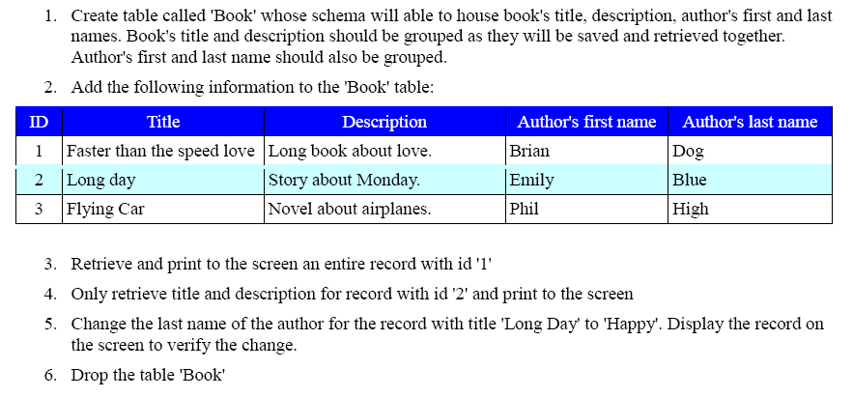
Exercise 1

Slide 50
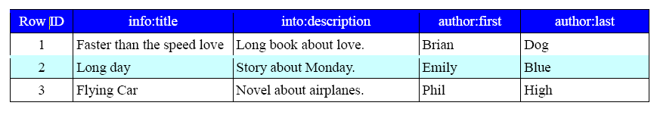
Exercise 2
Provided:
Perform:
Display all the records to screen for Book table (hint: Scan through records)
Display title and description for the first 2 records (hint: Scan through records)
Display cells which contain “Emily” word using Filters.
Retrieve row ids only using Filters

Slide 51
Test Your Understanding
What are types of access?
Why are filters used?

Slide 52
Summary
HBase is Column‐Oriented, Multi‐Dimensional, High Availability , High Performance
Non-relational, Distributed Database.
It runs on top of HDFS. It is well suited for sparse data sets, which are common in many big data use cases.
An HBase system comprises a set of tables. Each table contains rows and columns, much like a traditional database.
Apache HBase scales linearly to handle huge data sets with billions of rows and millions of columns, and it easily combines data sources that use a wide variety of different structures and schemas.
It provides a fault-tolerant way of storing large quantities of sparse data.
HBase is not a direct replacement for a classic SQL database.

Slide 53
Big Data
You have successfully completed –
HBase Basics Course

